Slide 1
Allen County Medical Reserve Corps Orientation
Notes:
Welcome to the Allen County Medical Reserve Corps Volunteer Orientation!
We are happy you have decided to join us in responding to the needs of our community. Your willingness to be trained and ready to serve in this important role greatly affects our efficacy during this crisis. This orientation will provide you the basic knowledge and skills needed to be able to assist the existing public health and medical communities in emergency response efforts. Our corps of volunteers has professionals from many disciplines, including medically trained and licensed individuals as well as active non-medically trained community members interested in giving back to their communities.
This orientation introduces volunteers to the procedures and protocols that will be used during an activation of the Medical Reserve Corps. It also provides all volunteers with the tools to safely and effectively respond to a wide variety of incidents affecting public health. This orientation has been made possible by the Allen County Medical Reserve Corps, with significant content and design input from the Franklin County & Columbus Medical Reserve Corps, Boston Public Health Commission, Harvard School of Public Health Center for Public Health Preparedness, and the DelValle Institute for Emergency Preparedness.

Slide 2
April 2020 Update
While this orientation was developed before the COVID-19 pandemic during non-emergency times, this orientation will give you a general overview of the purpose, history and management structure of the Medical Reserve Corps.

Slide 3
Objectives
Describe the purpose of the Medical Reserve Corps (MRC)
List potential reasons to activate you as an emergency volunteer
Steps to prepare for a potential emergency
Notes:
This course should help you achieve seven learning objectives. These include:
Describing the purpose of the Allen County Medical Reserve Corps, or Allen County MRC.
Identifying when, where, and why volunteers will be asked to respond.
Identifying the steps you and your family should take before an emergency to ensure your personal safety.
You should learn how you would be called to action if needed.
This orientation should explain your role and function as a volunteer. When you have completed it, you should be able to identify what type of role you are likely to play in a response.
You should learn about the management structure used in emergency response efforts and how you fit into it.
And finally, you should become familiar with additional volunteer opportunities, and- if interested- will learn about how to get more involved by becoming a leader in the Allen County MRC.

Slide 4
Objectives
Demonstrate activation procedures
Describe possible roles
Describe the management structure used
Describe volunteer leadership opportunities through the Allen County MRC

Slide 5
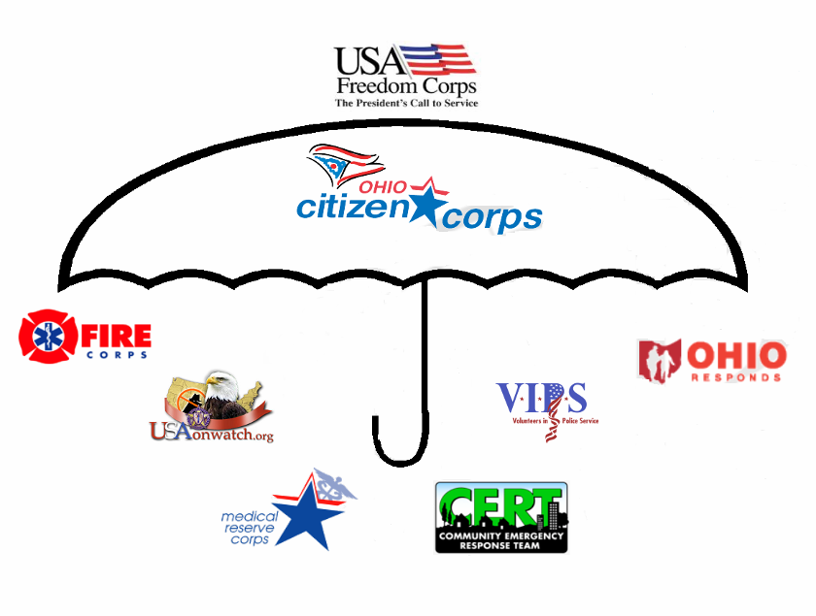
Notes:
This image shows potential volunteers opportunities throughout the US that fall under the Citizens Corp umbrella. Allen County currently has an MRC and VIPS program.
Citizen Corps: (as the umbrella organization) was started in 2002 largely in response to the attacks on 9/11. The federal administration at the time felt citizens needed a program that was two-fold: 1. prepared them as individuals and 2. created a registry of pre-trained and pre-credentialed volunteers
Fire Corps: is a corps of volunteers who support the fire departments in non emergency response activities
VIPS or Volunteers in Police Service is a corps of volunteers who support the police in non emergency activities (paperwork, IT, web development, education, etc)
Neighborhood Watch- A crime prevention program that was already in place but fit underneath the CC umbrella.
CERT or Community Response Team: A group of volunteers who take a 20 hour training course on personal preparedness- focused on making sure local neighborhoods are prepared.
The Medical Reserve Corps or MRC: A group of volunteers who support the public health and medical community in an emergency.
Ohio Responds: Is the database in which all the volunteers from each group are registered.

Slide 6
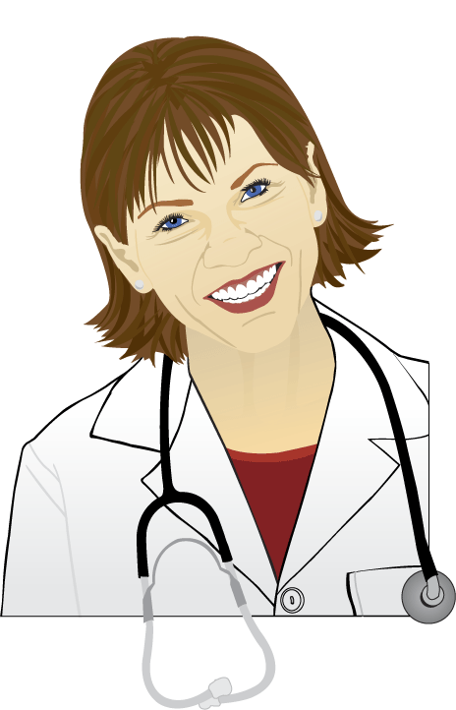
Brief History of the Allen County MRC
2002 Presidential Address -created the national MRC
Out of the Office of the Surgeon General
2006 – Allen County MRC started
Notes:
Just give a brief history here:
Like we mentioned earlier the program at the national level was started in 2002 largely in response to a need that was realized after 9/11. The hospitals and urgent cares surrounding ground zero were flooded with doctors and nurses who wanted to volunteer but the staff had no way to credential or verify those who showed up. Thus, people who were needed were not able to be used. The MRC strives to have a large database of pre-credentialed and pre-trained people who can show up in an emergency and respond effectively.
Ohio took the program and implemented it on a local level. Out of 88 counties, 83 have a local MRC unit.
On the local level: The MRC was created here Allen County in 2006 .The Allen County MRC is housed out of Allen County Public Health.

Slide 7
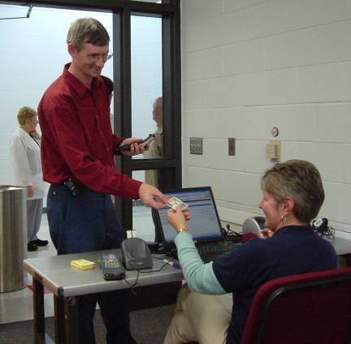
Goal of the Allen County MRC
Strengthen our capacity to respond to natural or manmade disasters.
Provide guidance in comprehensive disaster planning with public health focus.
Develop functional capacity for planning, activities, and workforce readiness related to disaster response.
Notes:
The goals of the Allen County MRC are to
Strengthen our capacity to respond to natural or manmade disasters.
Provide guidance in comprehensive disaster planning with public health focus.
Develop functional capacity for planning, activities, and workforce readiness related to disaster response.
Allen County MRC Volunteers fall into two primary categories. Those who have medical backgrounds, including nurses, doctors, clinicians, pharmacists or other licensed health professionals, and the remainder of the volunteers who are not medically licensed but have a desire to give back to the community. Community members, students, and others could fulfill important support roles for public health in an emergency. The role you could play will depend largely on your level of licensure, your interests and skills, and the needs of the response.

Slide 8
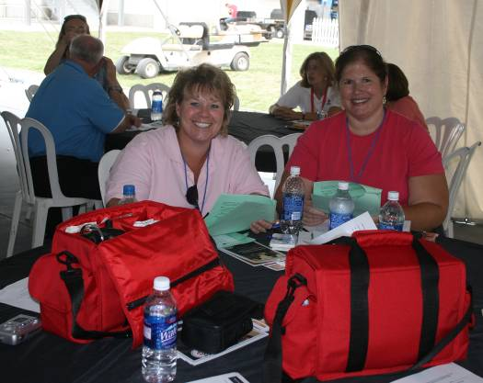
A corps of trained and credentialed volunteers
Notes:
Does not require a regular weekly or monthly commitment.
After completing this initial online orientation training, volunteers will be asked to enter their contact information into an online database with the Ohio Responds Registry

Slide 9
For MRC Volunteers: Role of Public Health in Emergency Response
Minimization of injury and suffering, promote community preparedness
Disease investigation and surveillance
Mobilize partnerships to identify and solve health problems before, during and after a disaster
Notes:
As a volunteer, you should have an understanding of what our public health organizations focus on during a disaster. These three points, the minimization of injury and suffering, disease investigation and surveillance, and the potential set up and drug distribution of a mass immunization or prophylaxis clinic are our main concerns, although additional community needs, such as patient care, might also be met through the public health infrastructure during a disaster.
We are planning and preparing for all types of hazards and will need volunteers to help us accomplish these tasks in the case of an emergency.
Number 4 on this list is an important component to our planning process and is essential to a community-based, coordinated and efficient response

Slide 10
Response Partners
Allen County Emergency Management Agency
Local Health Departments
Red Cross of West Central Ohio
Ohio Department of Health
Police and Fire Departments
Hospitals
Notes:
These partners work with the local health departments, federal agencies, and the MRC to create coordinated, local responses to community health needs during a disaster. Many county plans are being created and continually improved so that the health leadership effectively and efficiently responds to needs as they arise.
In Allen County, emergency responses are coordinated by the Allen County Emergency Management and Homeland Security Agency. This agency works with all other local stakeholders, like police departments, public schools, local health districts, nonprofits, media and others to create coordinated response plans for all types of potential hazards and to support the acquisition of needed supplies and support during an emergency.

Slide 11
Who are the volunteers?
Physicians, Nurses, Physician Assistants, Nurse Practitioners
Mental Health Professionals
X-Ray Techs, Respiratory Therapists, Lab Techs
Pharmacists
Health Educators and Teachers
Database Managers & Administrators
Support, Caregivers, Clerical
Bilingual Medical Professionals
Anyone who wants to help!
Notes:
There are 2 levels of volunteer involvement in the Allen County MRC – Response and leadership. This orientation is geared towards the largest group of volunteer responders, the Response Level Volunteers. In this segment we will discuss the goal of the Allen County MRC and what it means to be a Response Level Volunteer. Later, we will discuss opportunities for those who would like to become Leadership.

Slide 12
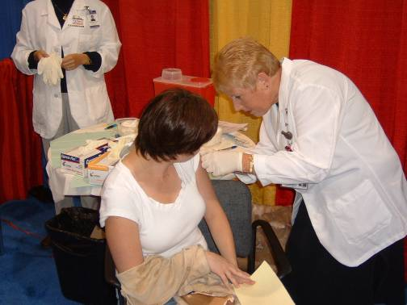
What It Means To Be A Response Level Volunteer
Support needs during an emergency
Notes:
Response level volunteers would provide much-needed assistance to the Allen County community during times of need. This could involve giving information to the public, registering people at special clinics, or if you are a licensed healthcare provider, preparing and dispensing medication or caring for the medical needs of the public. You should never be asked to perform a task you are not licensed or trained to perform or do not feel comfortable performing.
Response level volunteers are people who are interested in responding in an emergency but do not participate in activities on a regular or yearly basis. Which is just fine! Remember –we need a large group of volunteers already in the system. These volunteers maintain active status and respond to emergencies.

Slide 13
Roles: Volunteer assignments are made according to skill
Clinicians should perform medical roles
Non-clinicians/non medical people should assist with important support functions
Notes:
When you fill out your Ohio Responds Registry Profile you will provide information about your background, skills, and medical licensing. If you give information about your license, the MRC staff will verify that the license information you gave was accurate and that your license is up to date. We re-credential all licensed volunteers every 6 months. Only licensed professionals could be asked to respond to the medical or pharmaceutical needs of the public. Clinically trained volunteers might be assigned to dispense medication, give vaccinations, provide patient screening, triage or care for patients. All other volunteers could serve in much-needed support roles. Non-clinical volunteers might be asked to help people fill out forms, hand out information, direct traffic or maintain an orderly flow through the POD.

Slide 14
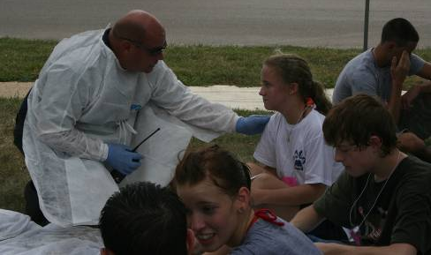
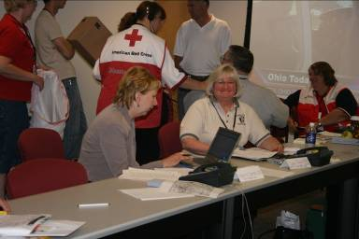
What is means to be a Leadership Level Volunteer
No weekly time commitment
Involves additional trainings, exercises, and 4 (or more) hours of volunteer time per year
Opportunities for leadership roles in a disaster
Notes:
As with response level volunteers, leadership level participation requires no weekly time commitment. Volunteers who are considered leadership level participate on the leadership team which meets via conference call or in person on a monthly basis. Volunteers are contacted about training events, exercises, and when there is an event that requires a response the same as all volunteers- the difference is that they also receive additional opportunities specific to their leadership abilities
Leadership opportunities include supervision of specific elements of a clinic or POD(point of distribution), such as overseeing treatment areas, or supervising patient flow into and out of the clinic or POD (point of distribution). These roles require additional training focusing on mental health, ICS, and other topics. If you are interested in serving in this capacity, please notify the MRC Coordinator.

Slide 15
What to do as a new volunteer:
As a new volunteer in the Allen County MRC you will be required to sign up in the Ohio Responds Registry and take the initial Ohio MRC orientation.
Once you have taken your orientation you are eligible to get your ID badge.

Slide 16
Liability Protection in Ohio Revised Code 3701.04 (B) and 5502.281 (C):
Provides liability protection to registered Ohio Medical Reserve Corps and Citizen Corps volunteers during local, state or federally declared emergencies, disasters, drills, exercises and trainings
Exempts a registered volunteer's personal information in the Ohio Responds Registry from public disclosure.
Notes:
As long as a volunteer is registered through the Ohio MRC in the Ohio Responds web site portal, is participating in an MRC sanctioned training, drill or emergency situation and has taken a training in the past 3 years the volunteer is not liable in damages to any person or government entity in tort or other civil action, including an action upon a medical, dental, chiropractic, optometric, or other health-related claim or veterinary claim, for injury, death, or loss to person or property that may arise from an act or omission of that volunteer.
This applies to a registered volunteer while providing services within the scope of the volunteer's responsibilities during an emergency declared by the state or political subdivision or in disaster-related exercises, drills, or other training activities, if the volunteer's act or omission does not constitute willful or wanton misconduct. This protection does not include the provision of any court fees, nor does it cover workman’s compensation.
At this time MRC volunteers would receive no workman’s compensation or health benefits in the event that a volunteer hurts himself or herself during a disaster.

Slide 17
Where Would the Response Efforts Likely Take Place?
Long term Care Facilities
Alternate Care Centers
Shelters
Outside
Community/Civic Centers
Notes:
Responses to public health or medical emergencies– the type of emergencies most likely to cause the activation of the Allen County MRC—will typically take place locally, in pre-selected clinic or POD sites. A POD is a Point of Distribution. This is essentially a mass clinic were medication would be passed out to the community on a large scale. These would be located in areas large enough to accommodate large groups of people: including volunteers staffing the response, and those who are seeking assistance. These sites have been pre-selected based on criteria that make them safe and easy for people to access. People affected by the public health emergency would be directed to locations closest to them to receive the help and medication they need.
Both traditional and temporary health care facilities may also be in need of volunteers. In these settings, a volunteer coordinator would manage your assistance to the response, making sure you were only asked to perform tasks you were comfortable with and licensed to perform.

Slide 18
Activation Procedures
Explain how you will know if you are or are not being activated
List the Five Phases of Activation
Define just-in-time training and describe how it should be used
Notes:
In this segment you will learn how you could be contacted in the event you are needed in response to an incident.
You will learn what steps you should take upon receiving the call to respond to an incident, and what happens during each of the 5 phases of activation. You will also learn more about event-specific training and how it is used to help volunteers respond more effectively.

Slide 19
Allen County MRC Activation Procedures
How You Could Be Contacted
Phase 1: Alert
Phase 2: Activate
Phase 3: Operations
Phase 4: Deactivation
Phase 5: Debrief
Notes:
In the event of a public health or medical emergency, MRC members will likely be activated through a five step system. These steps were designed to help volunteers understand where we are in the process of utilizing volunteers during a disaster, so that they can plan for their involvement. If an emergency develops quickly, Phase 1 may be skipped and phase 2 initiated first, with volunteers being contacted by phone immediately and asked to activate. This is a very rare occurrence. Volunteers will most likely be contacted in advance by email, and by phone call.

Slide 20
Phase 1: Alert Notification
Volunteers are briefed and told the likelihood of activation
Ohio Responds Volunteer Registry
Email, Telephone
Alerts can be sent via email and phone
This is essentially “stand by”
Notes:
All alerts will be sent out through the Ohio Responds Volunteer Registry. This is not only our database of volunteers but also our alerting system. We test this system twice a year. It is imperative that you make sure your contact information in this database is up to date.
The first phase of Emergency notification is the Alert: During this phase, if time allows, the MRC Coordinator will alert the MRC members about the status of a disaster situation, most likely by email through the Ohio Responds Registry. This method will be used if there is at least a 24 hour period, and more likely a 48 hour period, before activation is expected to begin. This will give the volunteer a sense of what has occurred and the likelihood of their future involvement in the response. This is not an activation- this is alerting the volunteers they are on standby!
If an event occurs in Allen County and you think the Allen County MRC may be activated, please check your email for any alert updates, and then please wait for a call from the emergency notification system. Waiting for the activation call ensures that you receive the appropriate information about where to report to receive your event-specific training. You are not permitted to self-deploy. Please wait for the activation call.
When the Ohio Responds Registry calls/emails volunteers during the emergency, the system will ask volunteers to indicate their ability to participate in the response. It will also provide you with important details about the event, including where to report.

Slide 21
Phase 2: Activation
Keep your contact information up to date
When you are activated, the system will call, or email you and request that you indicate your ability to assist in the event

Slide 22
Possible Roles for Volunteers During Activation
What is expected of volunteers
The types of roles volunteers may be assigned.
How this role will be assigned to you.
Notes:
In this section we will discuss what the Allen County MRC expects of our Volunteers, the types of roles volunteers may be assigned during an incident, and how this role will be assigned to you.

Slide 23
What Is Expected Of Volunteers During Activation?
Ensure your family is taken care of
Work safely and collaboratively
Follow leadership of your supervisor
Perform assigned function
Maintain patient confidentiality –HIPAA
Follow safety measures to protect yourself – social distancing, frequently wash surfaces, and not volunteering if you are ill.
Notes:
We ask all volunteers who participate in a response to thoroughly evaluate their ability to respond to an incident. For this reason, we ask Volunteers directly affected by an incident to take care of themselves and their family members. We also ask that volunteers work collaboratively with other members of a team, which could include other Volunteers, and your supervisor. It is important that all volunteers work within their specific function. We will not ask or expect you to perform duties outside your level of comfort and licensure.
Volunteering requires that you keep patient information confidential. Volunteers are expected not to share patient information with those who are not providing direct care to the patient. The law known as HIPAA– the Health Insurance Portability and Accountability Act- applies to all locations where health care is provided. It ensures privacy of the individuals we serve.

Slide 24
Potential Roles
Volunteer assignments are made according to skill
Clinicians should perform clinical roles
Non-clinicians should assist in other important functions
Please be flexible!
Notes:
In addition to response level and leadership volunteers we have volunteers with different skills sets. There are two types of volunteers, those with clinical backgrounds, and those who are not clinically trained. The application you filled out asked for information including contact information, special language skills, medical background, training and or licensure.
This information is entered into our database. During a response this information is utilized in order to assign volunteer roles appropriately. Volunteers with medical backgrounds and training include: Licensed Nurses, Doctors, Pharmacists, Allied Health Professionals, Faculty Members, Clinicians, Behavioral health professionals, and others with advanced clinical training and licensure.
Volunteers who are from Non-Medical backgrounds include: Community members, students of various disciplines, people with diverse language skills, administrators and others interested in lending their unique skills to response efforts.

Slide 25
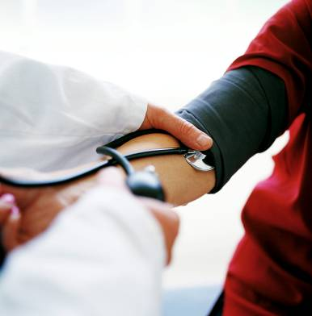
Potential Roles
Clinician roles:
Triage of patients
Medical interviewing
Assisting Response Personnel
First Aid, Education
Notes:
Now let’s look at some specific roles volunteers might fill. Medical volunteers provide direct and essential services to the community including:
Interviewing and triaging patients,
Dispensing medication or administering vaccinations in a POD, or Point of Dispensing,
Providing medical interpretation, or assisting other medical personnel with response activities.

Slide 26
Potential Roles During Activation
Non-clinician roles:
Assist with clinic or POD operations
Patient registration
Education
Computer systems management
Notes:
Non-Medical Volunteers are also a critical part of response efforts. Each non-medical volunteer performs an important function by supporting key elements of a response.
Some of these roles include assisting with clinic or POD operations: Registering patients, assisting in patient flow into a clinic or POD site, or monitoring lines patients are standing in, providing patients with education about the incident, the process as they move through the clinic or POD, or distributing fact-sheets about certain illnesses to patients. Providing language translation to patients who are non-English speaking is another important role for non-clinical Volunteers. Volunteers with clerical and computer skills will also be beneficial to the response effort.

Slide 27
Phase 3: Operations
The operations phase is the phase of the process where the actual volunteer service takes place.
The length of your shift will be determined by the MRC Coordinator
You will be processed through a Volunteer Reception Center
Security will be provided
Bring your MRC badge to the site along with other ID
Wear comfortable clothes and shoes
Bring any needed medication with you to the site, but try to keep personal belongings to a minimum
Food and water will likely be provided
Notes:
The operations phase is the phase of the process where the actual volunteer service takes place. There are some things you should do to ensure your comfort during a response. Be sure to dress comfortably, wear long pants and closed toe shoes, such as sneakers or boots. Comfortable shoes are a must- you may be asked to stand for long periods of time. Bring any personal items you may need, such as medication or eyeglasses. Your MRC ID will be absolutely necessary to volunteer with the response. Please bring them with you.
Please remember that security will be provided at the response site, and that Allen County MRC volunteers may not bring any weapons into the response setting. This rule will be enforced, and volunteer dismissal may ensue if this rule is broken.
Volunteer shifts are typically 8-12 hours long so food and drink will be provided on site. The operations phase is the phase of the process where the actual volunteer service takes place. There are some things you should do to ensure your comfort during a response. Be sure to dress comfortably, wear long pants and closed toe shoes, such as sneakers or boots. Comfortable shoes are a must- you may be asked to stand for long periods of time. Bring any personal items you may need, such as medication or eyeglasses. Your MRC ID will be absolutely necessary to volunteer with the response. Please bring them with you.

Slide 28
What to Do When You Receive the Call to Volunteer
Evaluate your ability to respond
Consider modes of transportation
Activate your family emergency plan
Report at the time and place specified
Notes:
Remember, your decision to participate in response efforts is voluntary. When you receive a request for assistance, evaluate whether you are in a position to help.
The Allen County MRC understands that your primary responsibilities lie with your family and employer. If your employer needs your help during an emergency, the Allen County MRC understands that you may not be able to serve with our organization during the emergency. Depending on the type of emergency, social and community activities, or even work obligations, may be cancelled, so your usual amount of free time may increase in certain cases.
If you rely on public transportation for travel, please consider the availability and frequency of these services, and watch the news for potential additional mass transportation options. If you feel that you are able to help, notify your family of your intentions. The next step is to report to the site at the time and place specified in the alert. Know that everything you need, including supplies and training, should be provided to you when you arrive.

Slide 29
Operations
Security will be provided
Volunteers for Allen County MRC may not bring weapons to any response effort
No guns, knives, or other implements intended to harm another individual will be allowed on the premises
Notes:
Please remember that security will be provided at the response site, and that Allen County MRC volunteers may not bring any weapons into the response setting. This rule will be enforced, and volunteer dismissal may ensue if this rule is broken.

Slide 30
Just-In-Time Training: a short training on the day of the response
Ensures specific procedures are fresh in your mind
Takes place at centralized location or at the site
Provides background information you need to safely participate in a response
Notes:
POD procedures will vary for different types of emergencies, so pre-event training for all volunteers is not practical. Just-In-Time training ensures that specific procedures are fresh in your mind.
All Allen County MRC volunteers are provided with Just-in-Time training at a centralized location or at the POD site before assisting in an event. This Just-in-time training serves as an orientation, and lets you meet other volunteers in your unit. Training should give you the appropriate background you need in order to safely and effectively participate in a response.
All emergency response in Allen County operates from a centralized command system. For the purposes of your volunteer service, you should report to only one supervisor within your unit. That supervisor should be introduced to you at the time of the training. All POD volunteers will receive preventative medicine or vaccine if needed.

Slide 31
Phase 4: Deactivation
This phase takes place when your volunteer services are no longer needed. During a disaster, if your availability permits you may be asked to serve for more than one shift. Deactivation occurs after you have served your last shift.
Notes:
This phase takes place when your volunteer services are no longer needed. During a disaster, if your availability permits you may be asked to serve for more than one shift. Deactivation occurs after you have served your last shift.

Slide 32
Phase 5: Debrief
This phase occurs after the disaster is over
Gathers feedback from all volunteers who respond to the event
Please let us know at this time if you have any needs that have not been met
May take the form of an interview, a survey, or a focus group session, and will assist in improving the future success of the MRC program/Volunteer Reception Center
Notes:
This phase occurs after the disaster is over. We will be gathering feedback and information from all volunteers who respond to the event to collect their thoughts on the Allen County MRC process, as well as to evaluated what worked and didn’t work about the response effort. This is the time to let us know if you have any future needs that have not been met. This may take the form of an interview, a survey, or a focus group session, and will assist in improving the future success of the MRC program.

Slide 33
Management Structure During Allen County MRC Activation
Define the terms Incident Command System (ICS)
Identify how you will know whom to report to within ICS
Name the response partners of the MRC
Notes:
In this section we will discuss the management tools used during an emergency response.
You should learn the basic components of the management tool, called the Incident Command System, and how it applies to you. Scene safety is an important element of the Incident Command System. You should learn proper scene safety and reporting procedures that you should use during an emergency response.

Slide 34
How Emergencies Are Managed
Emergencies and large events are managed using the Incident Command System (ICS)
Notes:
The incident command system, or ICS for short, is used to prepare for and respond to emergencies. It is used by all emergency response agencies and provides a common language for all responders- so that miscommunications are kept to a minimum. It also outlines a clear reporting structure which provides support- and creates accountability- for all members of the response team.

Slide 35
Basic ICS Structure
Notes:
The incident command system consists of several key positions shown on this slide.
These are not roles that response level volunteers should be tasked with; however it's important to know about the management structure under which you should operate.
The Incident Commander oversees the entire response.
The Safety Officer ensures that all activities occurring are safe for volunteers and the responders.
The Public Information Officer is tasked with coordinating information to the media and the public.
The Liaison Officer coordinates with other response agencies.
The remaining positions, called section chiefs, can be summarized quite simply-
Operations- carries out the response.
Planning- anticipates what could be needed in the coming hours or days.
Logistic- supplies operations with everything they need to carry out the response.
Finance- tracks what is spent on the response.
Allen County MRC volunteers should work under the operations or logistics section chiefs carrying out the response or providing support for it.

Slide 36
ICS Roles
The incident command system is lead by several key positions
These are not roles that volunteers should be tasked with; however it's important to know the management structure under which you operate
The Incident Commander oversees the entire response
The Safety Officer ensures that all activities are safe for volunteers/responders
The Public Information Officer coordinates information to the media and public
The Liaison Officer coordinates with other response agencies
The remaining positions, called section chiefs operate as follows:
Operations- carries out the response
Planning- anticipates what could be needed in the future
Logistics- supplies operations with everything they need to carry out the response
Finance- tracks what is spent on the response
You will likely work within the operations or logistics sections

Slide 37
Why ICS Works During Emergencies
Used by all emergency response agencies to prepare for and respond to emergencies.
Provides a common language for all responders to keep miscommunications at a minimum.
Outlines a clear reporting structure which provides support and creates accountability for all members of the response team.
Notes:
ICS works during emergencies because it addresses the most common problems encountered during an emergency response: poor communications and lack of clear authority. Provides structure for integrating with other responding agencies, because all emergency response agencies use the same ICS system to prepare for and respond to emergencies.
Important to minimize agency-specific jargon
Emergencies require standardized methods for:
Evaluating the incident
Reporting the information
Responding to the victims
ICS provides a very specific reporting structure so that each responder knows what they are responsible for and whom to report. This also assures that adequate communications occur between volunteer responders, among responding agencies, and with the media.

Slide 38
Why ICS Works During Emergencies
Provides structure for coordinating with media & public through the Public Information Officer.
IF YOU ARE APPROACHED BY THE MEDIA, CONTACT YOUR SUPERVISOR IMMEDIATELY

Slide 39
How ICS Applies To You
Answer to only one person.
Stay within assigned roles.
For safety reasons, never enter a scene, POD, or clinic site without first telling your supervisor.
As part of the reporting structure, you should not start a new role, leave your old role, or leave the site without first speaking with your supervisor.
Notes:
ICS keeps volunteers- and the people we serve- safe.
ICS creates a system where you will answer to one person, you stay within your assigned role, do what you are assigned to do within that role, and you know how to do it.
As part of the reporting structure, you should not start a new role, leave your old role, or leave the clinic or POD without first speaking with your supervisor. It is essential that all personnel at a response follow these basic rules in order to assist in a unified response.

Slide 40
Scene Safety Tips
Follow the pre-established Emergency Management Structure
Do not leave your assigned area without notifying your supervisor
Let your supervisor know when you need a break
Never talk to media representatives without first alerting your supervisor
Notes:
For your safety, and the safety of others, it is important that you follow the pre-established incident management structure. It is also important that you do not leave your assigned area without first notifying your supervisor. Also, remember to monitor how you’re feeling and be sure to let your supervisor know when you need to take a break.

Slide 41
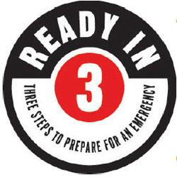
Simple things you should do ahead of time to plan for you and your family
Make a plan
Make a kit for home, car, work
Listen
More info: www.ready.gov
Notes:
Because you will most likely be asked to be away from home for at least 8 hours, it is important to have a plan in place to ensure your family and other loved ones will be taken care of while you are gone. Having a household emergency plan is also essential for emergencies that may require you and your family to stay at home and shelter-in-place. ‘Shelter in Place’ means to find a safe place right where you are. An emergency plan includes two elements- a plan for staying home or leaving. It is important to think through ahead of time how you will contact each other and where you should meet if you can’t go home. An emergency supply kit ensures that you have enough food, water, medication and essential supplies stockpiled. Listen for information about what to do and where to go during an actual emergency.

Slide 42
Steps to Prepare For a Potential Emergency
List your daily responsibilities that affect your ability to respond.
Write a personal/ family emergency plan.
Practice appropriate self-care.
Notes:
While it is important for everyone to prepare for emergencies, as a Allen County MRC volunteer it is especially important because you are likely to be away from home during a public health emergency. In this section, we will discuss the steps you and your family should take before an emergency occurs. These include:
Thinking about your daily responsibilities, and how they would be affected during an emergency, creating a family emergency plan, and understanding and practicing appropriate self-care.

Slide 43
Definition of Disaster
A disaster is an event that exceeds the capabilities of the current response infrastructure.
Disaster = Need > Resources
Notes:
So for our training purposes here today we want to go ahead and talk about what a disaster is:
A disaster is an event that exceeds the capabilities of the current response infrastructure. When disasters occur, the county, state or nation in which the disaster occurs could declare a state of emergency. Disasters may also occur on a smaller scale, when a local hospital, public health or Red Cross response system becomes overwhelmed, and the need is greater than the ability of these organizations to respond. When you signed up for the MRC, you chose to respond at the county, state or federal level. We will only contact you for disasters occurring in the area in which you selected.

Slide 44
Make a Plan
Include Contact numbers/emails for those you may need to reach - If phone lines are down email may still be working
Include An out-of-town friend to act as your designated household contact
Include A plan for leaving quickly
Notes:
Creating an emergency plan before an incident occurs ensures that those who depend on you for care are safe and accounted for. This plan should include all of those who are in your household like including pets. Include all information for those you may need to contact, including school, home, office and cellular phone numbers.
Consider having an out-of-town friend or relative act as your designated contact person. Sometimes local phone lines are tied up when a large number of people are attempting to make calls. Long distance carriers are sometimes available when local lines are tied up. Even if telephone lines are not working, email may be accessible. Let your family know ahead of time of your plans to be a volunteer. Ask a friend or relative to care for your family members, children, or pets while you are assisting with a response. Make sure this person understands their role, and be sure to share your emergency plan with them. Make a plan for several different routes in different directions, and bring an emergency kit with you. Try to bring your pets, but also have a plan for your pet’s care in case you can’t bring your pet with you.

Slide 45
Plan with your family

Slide 46
Emergencies happen. It can be a tornado, house fire, flood or terrorist attack. No one wants to think about disasters, but being prepared for an emergency can help protect your family.

Slide 47
Make a Kit
First aid supplies, prescription medications
Battery powered radio, flashlight, and extra batteries
Notes:
Having and maintaining an emergency supply kit is another important element of your emergency plan. It ensures that those in your household who remain at home are well-prepared if they are asked to “shelter-in place” at home. When creating a kit, think about the types of things that your family would need if they were without power or water for 3 days, or if there was a serious blizzard. This should include first aid supplies and medications, a flashlight, a battery powered radio and batteries.

Slide 48
Make a Kit
Non-perishable food, a can opener
One gallon of bottled water per
person per day
Multivitamins
Cash and copies of important family documents
Notes:
Examples of what could be in your kit:
Your kit should also include non-perishable food items such as tuna fish, granola bars, and dried fruit.
Be sure to include a gallon of water per person per day.
Don’t forget to include water for your pets.
Multivitamins are an important part of an emergency kits, to keep you healthy during stressful times.
Keep a copy of important family documents, including passports or other photo identification, in your supply kit. This allows you to be able to quickly leave your house with all your necessary paperwork if leaving becomes necessary. Include photocopies of any prescription medications you may be taking.

Slide 49
Make a Kit
Special needs items for babies, pets, other dependants
Keep a copy of your plan with your kit
Include a smaller kit for your car and office
Notes:
If there are members of your household that have special needs, make sure to also include those items. Don’t bring this kit with you to your volunteer site; keep it in a safe place in your home in the event of an emergency. And don’t forget about supplies for your pets! A kit in your car should include a gallon of water, several cans of food, a sleeping bag, extra money and first aid supplies. Keep a copy of your family’s emergency plan with your supply kit for easy reference.

Slide 50
Shelter-In-Place
Stay inside/close and lock all doors.
Turn off fans and air conditioners.
Seal windows, doors and vents.
Move to the interior of the home or office.
Notes:
Another component of emergency preparedness involves being prepared to “shelter-in- place.” Some situations, such as the release of certain types of contaminants into the environment, will not require a POD-based response. These conditions may require you to shelter-in-place. You will be informed via media outlets if you should take this precaution to keep yourself and your family safe. When you shelter-in-place, you may be asked to stay inside and lock your doors. Turn off all fans and air conditioners, and seal windows, doors and vents. Move to the most interior portion of the house or office, making sure to have a telephone and a radio to keep abreast of information updates and further instructions.

Slide 51
Shelter-In-Place
Have a telephone (landline and cell phone)
Radio/TV access (for information updates)
Which room in your house would be best to ‘shelter in place’? Does it have a radio/TV handy?
Notes:
Which room in your house would be best to ‘shelter in place’? Does it have a radio/TV handy?

Slide 52
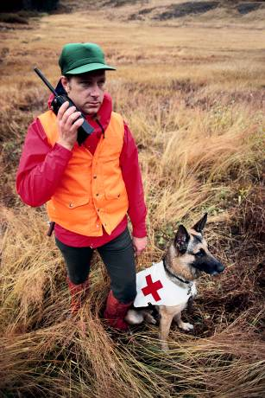
Listen
To the media, through TV and internet.
To a battery-powered radio, with extra batteries.
To community officials. Local agencies have developed plans to respond to disasters and it is important for the public to follow instructions and advice.
It is important to stay calm in an emergency.
Notes:
To the media, through TV and internet
To a battery-powered radio, with extra batteries
To community officials. Local agencies have developed plans to respond to disasters and it is important for the public to follow instructions and advice
It is important to stay calm in an emergency

Slide 53
Self Care
Taking appropriate care of yourself is something you should practice every day
The severity of stress you feel could increase during an emergency
Be aware of your typical reactions to stress, and mindful of stress relieving activities
Notes:
Another important thing to think about before an emergency is self-care. We all experience some stress on a daily basis, but emergencies bring new and intensified stress.
Self care is an important tool that could help you to maintain mental and physical health.
Taking proper care of yourself is something that you should do every day.
Be aware of your typical reactions to stress, and get to know what activities can help alleviate stress for you.

Slide 54
Stress Management and Emergency Response
Participating in a response may cause stress.
Be sure to identify your own reactions to stress and learn about effective stress management.
Notes:
Emergency events are stressful not only for those who are directly affected by the incident, but also to those who participate in response efforts. Emergency responders often disregard their own comfort to ensure that the people they serve receive the help needed. Remember you are best able to help others when you take proper care of yourself. Be conscious of how you feel as you participate in a response. Be sure to communicate with your supervisor at the response site if you need to take a break to manage your stress. Some of the MRC volunteers asked to respond to an event will be mental health professionals. These people will be available to support the staff and volunteers at the site.

Slide 55
Alleviate everyday stress
Be aware of your limits
Be physically active
Drink plenty of water
Get plenty of sleep
Notes:
Many actions could help prevent undue stress before it occurs, as well as manage it while you are in a stressful situation. For example: Know and respect your limits. If you feel exhausted and need time off, take a break. Studies have shown that physical activity is a great way to help alleviate stress. Go for a 15 minute walk during a lunch or coffee break, join your local gym, or participate in a group exercise class. Maintain proper hydration by drinking plenty of water. Avoiding excessive use of caffeine and alcohol could also be helpful. Getting enough sleep is a challenge for many people on a daily basis, and even more difficult during stressful situations, but try to get as much sleep as possible.

Slide 56
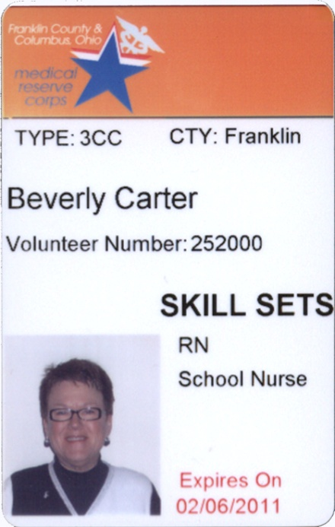
Finally-Next Steps!
Enter your contact information in the Ohio Responds Volunteer Database
Stay tuned for newsletters, training opportunities, and event activation
Notes:
You have almost completed your orientation. The following are a few next steps for you to take. After you have entered your information in the Ohio Responds Volunteer Registry and been approved the system should periodically contact you asking you to update your contact information. Please do so! We will likely use this system to contact you in an emergency situation, so we must have accurate information in this system in order to contact you in a timely manner. Also, stay tuned for newsletters, training opportunities, and event activation.

Slide 57
______________________ Name
I acknowledge I have read over and completed the MRC orientation:

Slide 58
Heroes aren’t born, they volunteer
Allen County Medical Reserve Corps
Allen County Public Health
Notes:
Thank you for your participation in the Allen County Medical Reserve Corps. Your participation helps to ensure the good health of our community following a public health or medical emergency. Thank you for your participation, support and willingness to serve.

